Slide 1
CHAPTER 1
INTRODUCTION TO MICROCONTROLLERS AND PIC18 FAMILY

Slide 2
OUTLINE
  Overview of microcontrollers
  Overview of PIC18 family
  PIC18 PIN connection
  The WREG Register
  File Register
  Access Bank
  Use of Instructions with the Default Access Bank
  PIC18 Status Register
  PIC18 Data Format and Directives
  The Program Counter and Program ROM Space in the PIC18
  RISC Architecture in the PIC18

Slide 3
Objective
Compare and contrast microprocessor and microcontroller
Describe the advantages of microcontroller
Compare and contrast the various of the PIC family
Examine the data RAM file Register of the PIC microcontroller
Manipulate data using the WREG & MOVE
Perform simple operations such ADD and file Register using and access bank in the PIC microcontroller
Explain the purpose of the status register
Discuss data RAM memory space allocation in the PIC microcontroller
List SFRs of the PIC microcontroller
Describe PIC data types and directives
Understand the RISC and Harvard architectures of the PIC microcontroller

Slide 4
1.1. Overview of microcontrollers
Microcontroller and Embedded Processors
Microcontroller VS General purpose microprocessor
Microcontroller for embedded systems
X86 PC Embedded Application

Slide 5
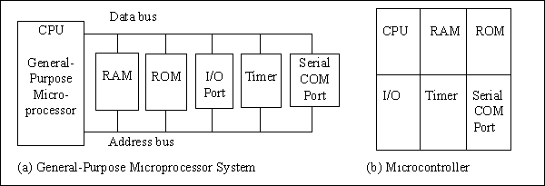
1.1. Overview of microcontrollers
Figure 1-1. Microprocessor System Contrasted With Microcontroller System

Slide 6
1.1. Overview of microcontrollers
Choosing a microcontroller
The major 8-bit
  Freescale Semiconductor’s (formerly Motorola) 68HC08/68HC11
  Intel’s 8051
  Atmel’s AVR
  Zilog’s Z8
  PIC from Microchip Technology

Slide 7
1.1. Overview of microcontrollers
Criteria for Choosing microcontroller
Meeting the computing needs of the task at hand efficiency and cost effectively
Availability of SW and HW development tools
  Compilers
  Assemblers
  Debuggers
  Emulators
Wide availability and reliable source

Slide 8
1.1. Overview of microcontrollers
Criteria for Choosing microcontroller
Meeting the computing needs of the task at hand efficiency and cost effectively
  Determine its type, 8-bit,16-bit or 32-bit
  Speed
  Packaging (40-Pin or QFP)
  Power consumption
  The amount of RAM and ROM
  The number of I/O pins and the timer
  Cost per unit
  Ease of upgrade.

Slide 9
1.1. Overview of microcontrollers
Microcontroller Data width
8-bit Microcontrollers
  PIC10, PIC12, PIC14
  PIC16, PIC17, PIC18
16-bit Microcontrollers
  PIC24F, PIC24H
32-bit Microcontrollers
  PIC32
16-bit Digital Signal Controllers
  dsPIC30, dsPIC33F
Notes:
x

Slide 10
1.2. Overview of PIC18 family
An 8-bit microcontroller called PIC is introduced in 1989 by Microchip Technology Corporation
It includes
  Small Data Ram
  Few bytes of Rom
  One timer
  I/O ports

Slide 11
1.2. Overview of PIC18 family –Features
RISC Architecture
On-chip program, Code, ROM
Data EEPROM
Timers
ADC
USART
I/O Ports

Slide 12
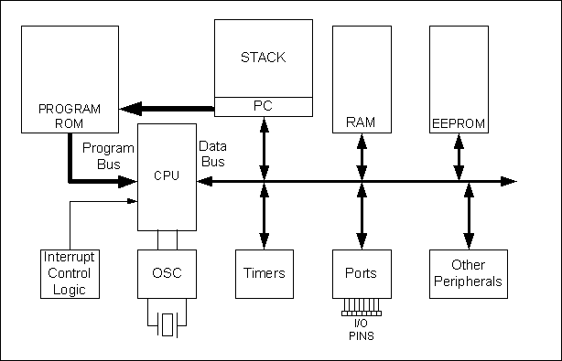
1.2. Overview of PIC18 family
Figure 1-2. Simplified View of a PIC Microcontroller

Slide 13
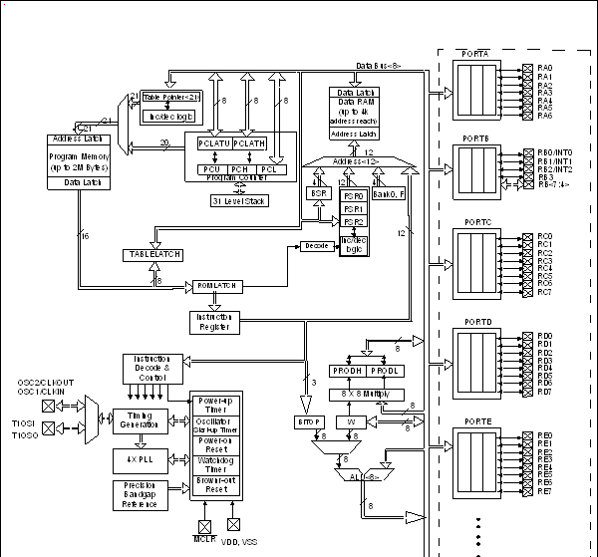
1.2. Overview of PIC18 family
Figure 1-3. PIC18 Block Diagram

Slide 14
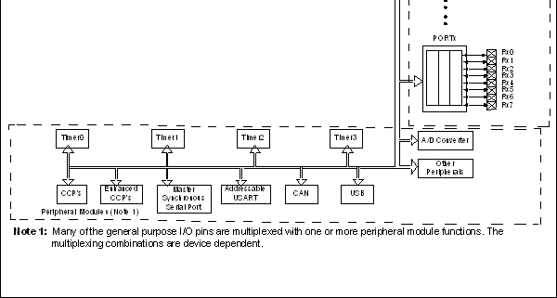
1.2. Overview of PIC18 family
Figure 1-3. PIC18 Block Diagram (continued)

Slide 15
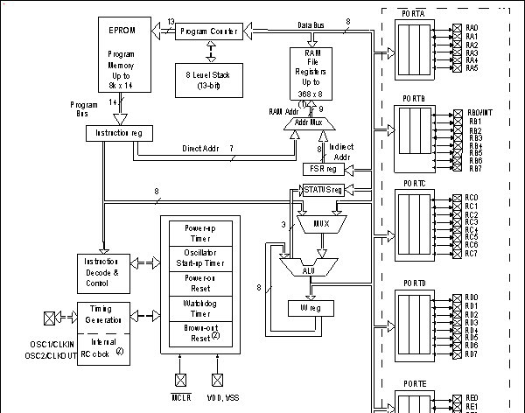
1.2. Overview of PIC18 family
Figure 1-4. PIC16 Block Diagram

Slide 16
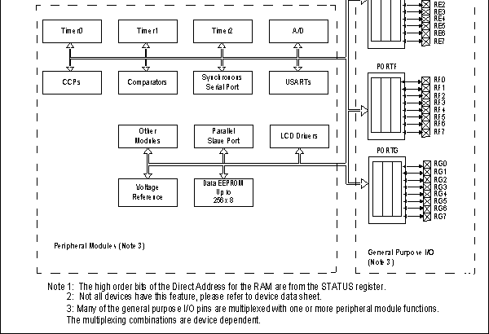
1.2. Overview of PIC18 family
Figure 1-4. PIC16 Block Diagram (continued)

Slide 17
1.2. Overview of PIC18 family
PIC microcontroller program ROM
PIC exists in terms of different speed and the amount of on-chip RAM/ROM
Compatibility is restricted as far as the instructions are concerns.
PIC 18 can support up to 2MB
Generally, they come with 4KB – 128KB
Available in flash, OTP, UV-EPROM, and masked.

Slide 18
1.2. Overview of PIC18 family
PIC18Fxxxx with flash
Used for product development
PIC18Cxxxx and Masked PIC
OTP
  One time programmable
  C indicates the OTP RPM
  Used for mass production
  Cheaper
Masked
  program will be burned into the PIC chip during the fabrication process

Slide 19
1.2. Overview of PIC18 family
PIC microcontroller data RAM and EEPROM
Max. 4096 Bytes (4 kB) of data RAM space.
Data RAM space has two components
  Varied GPR, General Purpose RAM
    For read/write and data manipulation
    Divided into banks of 256 B
  Fixed SFR, Special Function Registers
Some of PICs have a small amount of EEPROM
  Used for critical data storing

Slide 20
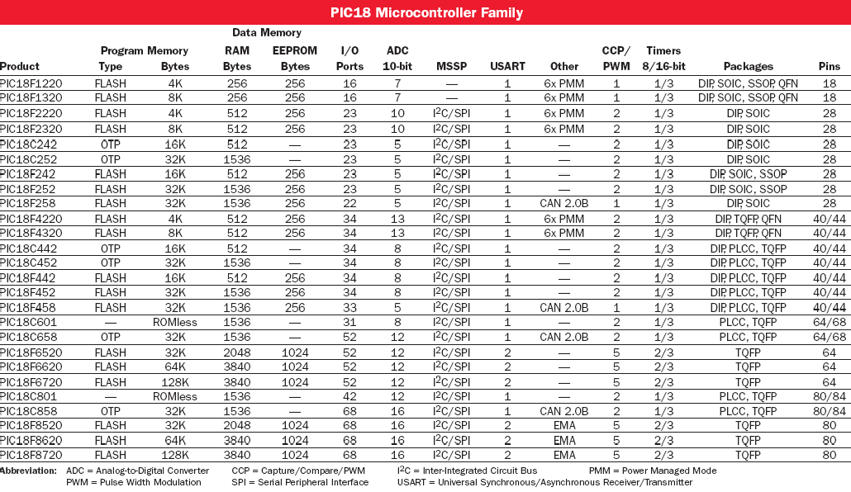
1.2. Overview of PIC18 family

Slide 21
1.2. Overview of PIC18 family
PIC microcontroller peripherals
CAN- (Controller Area Network),
LIN- (Local Interconnect Network),
USB- (Universal Serial Bus),
I²C- (Inter-Integrated Circuit),
SPI- (Serial Peripheral Interface),
Serial or Ethernet Interface
ADC - Analog Digital Converter
USART- Universal Synchronous Asynchronous Receiver Transmitter

Slide 22
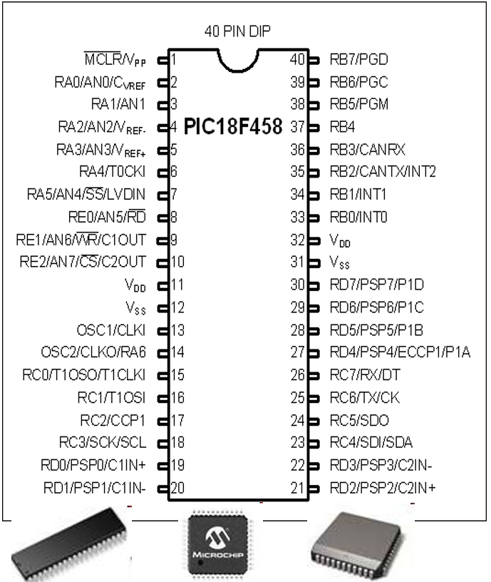
1.3. PIC18 PIN connection
DIP (dual in line package) shown
– QFP (quad flat package) and LLC
(leadless chip carrier) is also available
Vdd typical 5V but can be set; 2 pins
Vss (GND) 2 pins (ground bounce noise reduction)
OSC1 and OSC2: for external quartz oscillators 0-40MHz, configurable
MCLR – master clear reset – creates power on reset

Slide 23
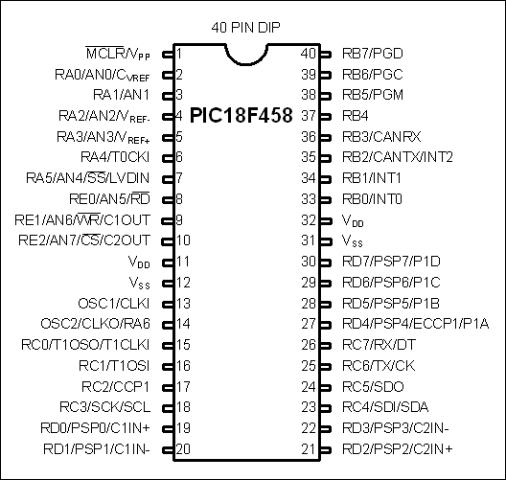
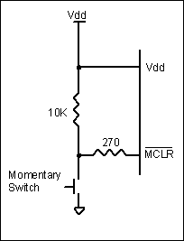
1.3. PIC18 PIN connection
PIC18F458 Power-On Reset Circuit
At MCLR:
PC, WREG, SP reset to 0
TRISA-TRISE reset to FF

Slide 24
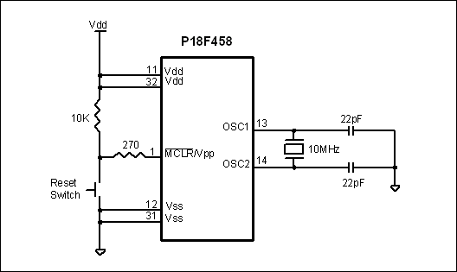
1.3. PIC18 PIN connection
Minimum Connections on a Pic18F (With a Crystal)

Slide 25
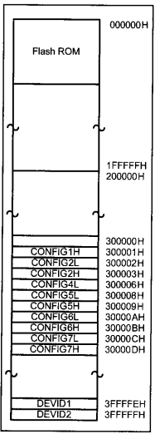
1.3. PIC18 PIN connection
Configuration Registers
In ROM beyond addressable
CONFIG directive in the source code is used to write to it, e.g.,
  CONFIG OSC=HS
  CONFIG OSCS = OFF OR
  CONFIG OSC=HS , OSCS = OFF
MPLAB can directly manipulate them inside a project
Can be accessed through table reads and writes from the microcontroller
CONFIG5 and up are in general for code protection settings

Slide 26
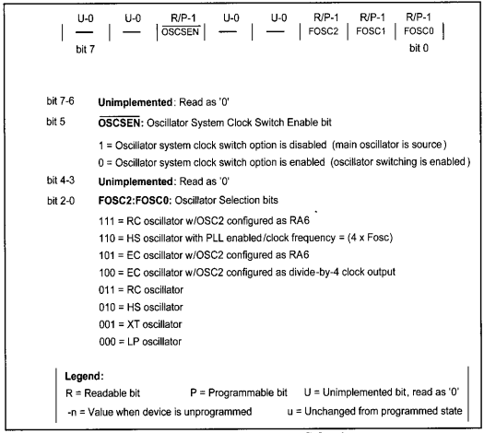
1.3. PIC18 PIN connection
CONFIG1H - Oscillator
FOSC default is RC (111) – on chip oscillator with RC circuit attached to OSC1
EC = external oscillator connected to OSC1
HSPLL, HS, XT, LP, are crystal options with stability and power consumption (in this descending order) differences (HSPLL quadruples the frequency)
There is an internal 32kHz oscillator that can be enabled by the OSCEN bit

Slide 27
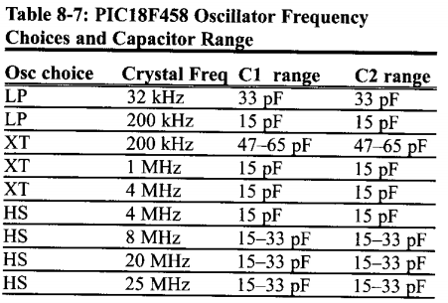
1.3. PIC18 PIN connection
Clock

Slide 28
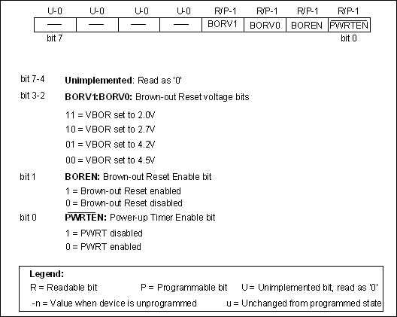
1.3. PIC18 PIN connection
CONFIG2L – Initial Transients
Controls stable voltage and frequency during reset
Power up timer (PWRT) keeps the processor start up so that supply voltage can be stabilized
Oscillator start up timer does the same for the oscillator
Brown out suspends the processor if supply voltage falls below a set level
Recall: the higher the frequency the higher of a supply voltage we need

Slide 29
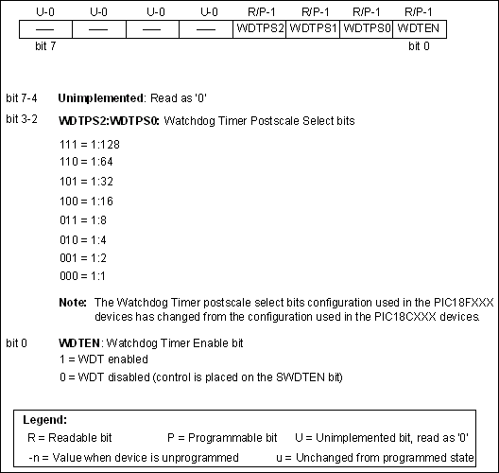
1.3. PIC18 PIN connection
CONFIG2H – Rottweilers
Errrr, watchdog timers
Can verify if the system still is executing meaningful instructions or is stuck (ROM corruption, noises, PC failures) and issue a reset
WDTPS determines the time-out

Slide 30
1.3. PIC18 PIN connection
CONFIG2L – Initial Transients
Controls stable voltage and frequency during reset
Power up timer (PWRT) keeps the processor start up so that supply voltage can be stabilized
Oscillator start up timer does the same for the oscillator
Brown out suspends the processor if supply voltage falls below a set level
Recall: the higher the frequency the higher of a supply voltage we need

Slide 31
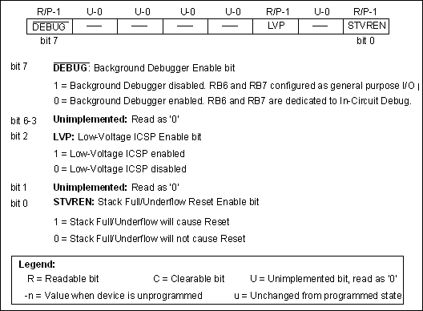
1.3. PIC18 PIN connection
CONFIG4L – Debuggers, etc
There are special purpose in-circuit debuggers that can be used with PICs (RB6 and RB7 unusable)
SVREN: Stack has only 31 locations if it over (or under) flows we can ask for a reset
LVP: low voltage in circuit programming bit (RB5 becomes unusable)

Slide 32
1.4. The WREG Register
Many registers for arithmetic and logic operation.
The WREG (WORking Register) Register is one of the most widely used registers of the PIC
  8-bit register 🡪 any data larger than 8 bits must be broken into 8-bits chunks before it is processed.
  There is only one .
D7 D6 D5 D4 D3 D2 D1 D0

Slide 33
1.4. The WREG Register
MOVLW
Moves 8-bit data into WREG
  MOVLW k; move literal value k into WREG
Example
  MOVLW 25H
  MOVLW A5H
Is the following code correct?
  MOVLW 9H
  MOVLW A23H

Slide 34
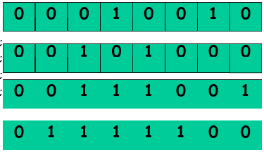
1.4. The WREG Register
ADDLW
ADDLW k; Add literal value k to WREG (k +WREG)
Example
  MOVLW 12H
  ADDLW 16H
  ADDKW 11H
  ADDLW 43H

Slide 35
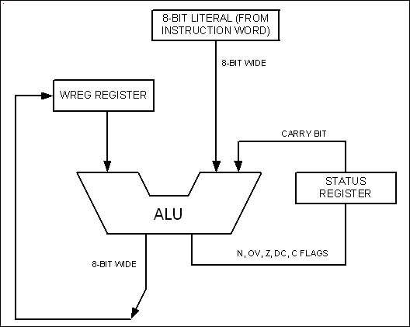
1.4. The WREG Register
Figure 2-1. PIC WREG and ALU Using Literal Value

Slide 36
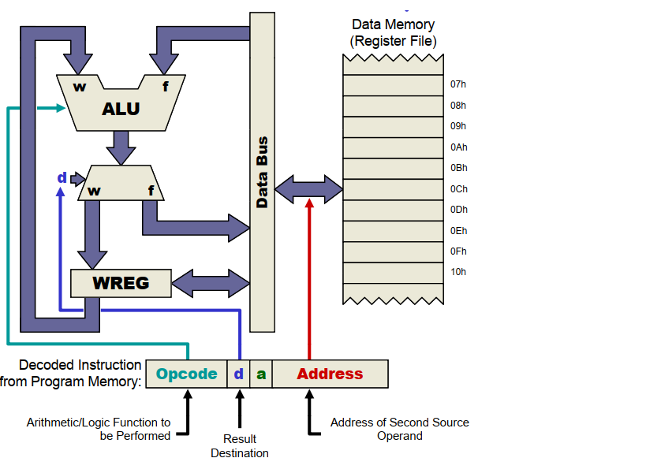
1.5. File Register
Register File Concept
Register File Concept: All of data memory is part of the register file, so any location in data memory may be operated on directly.
All peripherals are mapped into data memory as a series of registers
Orthogonal Instruction Set: ALL instructions can operate on ANY data memory location

Slide 37
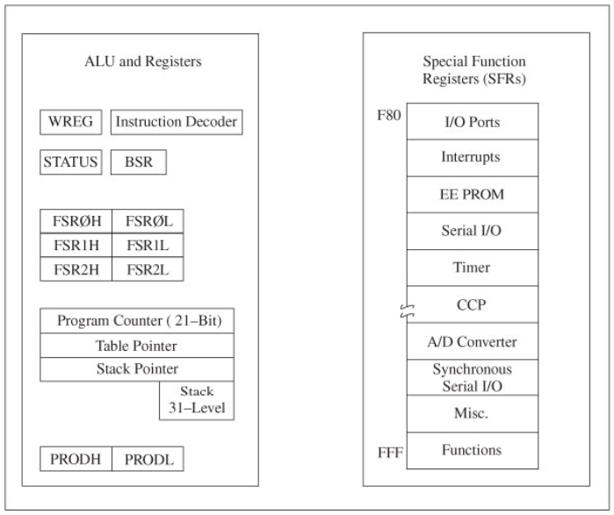
1.5. File Register
PIC18F Programming Model

Slide 38
1.5. File Register
Special Function Registers
dedicated to specific functions such as ALU status, timers, serial communication, I/O ports, ADC,…
The function of each SFR is fixed by the CPU designer at the time of design it is used for control of the microcontroller or peripheral
8-bit registers
Their numbers varies from one chip to another.

Slide 39
1.5. File Register
General Purpose RAM
Group of RAM locations
8-bit registers
Larger than SFR
  Difficult to manage them by using Assembly language
  Easier to handle them by C Compiler.

Slide 40
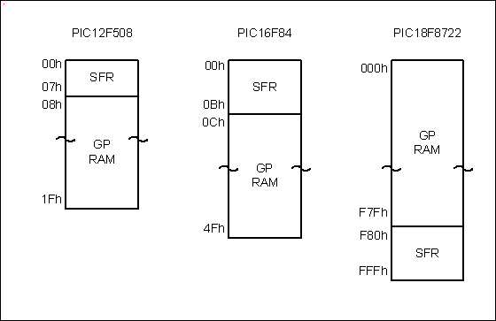
1.5. File Register
Figure 2-2. File Registers of PIC12, PIC16, and PIC18

Slide 41
1.5. File Register
GPRAM VS. EEPROM
An add-on memory
Can be zero size

Slide 42
1.6 Access Bank
The PIC18 Family can have a max. of 4096 Bytes.
The File Register
  has addresses of 000- FFFH
  divided into 256-byte banks
  Max. 16 banks
At least there is one bank
  Known as default access bank.
Bank switching is a method used to access all the banks

Slide 43
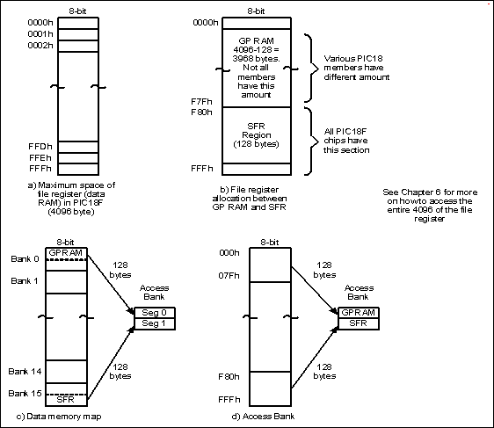
1.6 Access Bank
Figure 2-3. File Register for PIC18 Family

Slide 44
1.6 Access Bank
Access bank in the PIC18
It is 256-Byte bank.
Divided into equal two discontinuous sections (each 128 B).
  GP RAM, from 0 to 7FH
  SFR, from F80H to FFFH

Slide 45
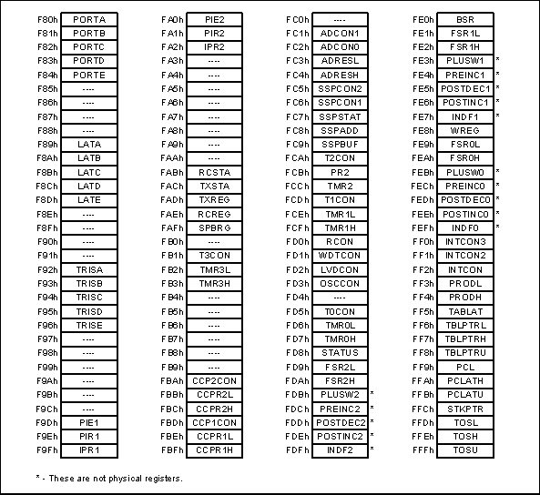
1.6 Access Bank
Figure 2-4. SFRs of the PIC18 Family.

Slide 46
1.6 Access Bank
Using instruction with the default access bank
We need instruction to access other locations in the file register for ALU and other operations.
  MOVWF
  COMF
  DECF
  MOVF
  MOVFF

Slide 47
1.6 Access Bank
MOVWF instruction
F indicates for a file register
MOVWF Address
It tells the CPU to copy the source register, WREG, to a destination in the file register.
  A location in the SPR
  A location in GP RAM

Slide 48
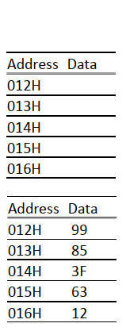
1.6 Access Bank
Example 2-1
MOVLW 99H
MOVWF 12H
MOVLW 85H
MOVWF 13H
MOVLW 3FH
MOVWF 14H
MOVLW 63H
MOVWF 15H
MOVLW 12H
MOVWF 16H

Slide 49
1.6 Access Bank
ADDWF
Adds together the content of WREG and a file register location
ADDWF File Reg. Address, D
The result will be placed in either the WREG or in the file register location
  D indicates the destination bit
If D=0 or (D=w)
  The result will be placed in the WREG
If D=1 or (D=f)
  The result will be placed in the file register

Slide 50
1.6 Access Bank
Example 2-2: State the content of file register location and WREG after the following program
MOVLW 0
MOVWF 12H
MOVLW 22H
ADDWF 12H, F
ADDWF 12H, F
ADDWF 12H, F
ADDWF 12H, F

Slide 51
1.6 Access Bank
Example 2-3: State the content of file register location and WREG after the following program
MOVLW 0
MOVWF 12H
MOVLW 22H
ADDWF 12H, F
ADDWF 12H, W
ADDWF 12H, W
ADDWF 12H, W

Slide 52
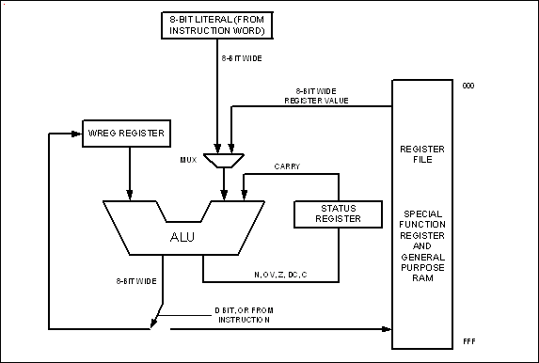
1.6 Access Bank
Figure 2-5. WREG, fileReg, and ALU in PIC18

Slide 53
1.6 Access Bank
COMF instruction
COMF File Reg. Address, D
It tells the CPU to complement the content of fileReg and places the results in WREG or in fileReg.

Slide 54
1.6 Access Bank
Example 2-4: Write a simple program to toggle the SFR of Port B continuously forever.

Slide 55
1.6 Access Bank
DECF instruction
DECF File Reg. Address, D
It tells the CPU to decrement the content of fileReg and places the results in WREG or in fileReg.
Example:
  MOVLW 3
  MOVWF 20H
  DECF 20H, F
  DECF 20H, F
  DECF 20H, F

Slide 56
1.6 Access Bank
DECF instruction
DECF File Reg. Address, D
It tells the CPU to decrement the content of fileReg and places the results in WREG or in fileReg.
Example:
  MOVLW 3
  MOVWF 20H
  DECF 20H, w
  DECF 20H, w
  DECF 20H, w

Slide 57
1.6 Access Bank
MOVF instruction
MOVF File Reg. Address, D
It is intended to perform MOVFW
  MOVFW isn’t existed
If D=0
  Copies the content of fileReg (from I/O pin) to WREG
If D=1
  The content of the fileReg is copied to itself. (why?)

Slide 58
1.6 Access Bank
MOVF instruction
MOVF File Reg. Address, 0

Slide 59
1.6 Access Bank
Example 2-5: Write a simple program to get data from the SFRs of Port B and send it the SFRs of PORT C continuously.

Slide 60
1.6 Access Bank
Example 2-6: Write a simple program to get data from the SFRs of Port B Add the value 5 to it and send it the SFRs of PORT C

Slide 61
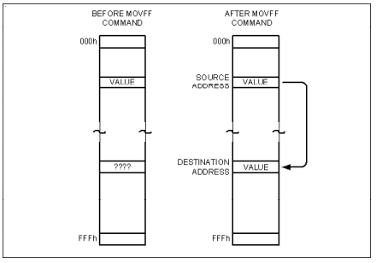
1.6 Access Bank
MOVFF instruction
It copies data from one location in FileReg to another location in FileReg.
MOVFF Source FileReg, destination FileReg

Slide 62
1.6 Access Bank
Example 2-7: Write a simple program to get data from the SFRs of Port B and send it the SFRs of PORT C continuously.

Slide 63
1.7 Status Register
To indicate arithmetic conditions
It is a 8-bit register
  Five bits are used
D0: C Carry Flag
D1: DC Digital Carry Flag
D2: Z Zero Flag
D3: OV Overflow Flag
D4 N Negative Flag

Slide 64
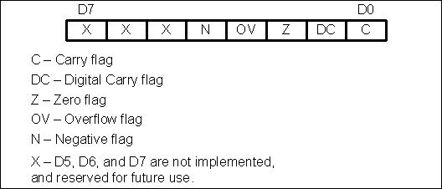
1.7 Status Register
Figure 2-7. Bits of Status Register

Slide 65
1.7 Status Register
Example 2-8: Show the status of the C, DC, Z flags after the following addition instruction
MOVLW 38H
ADDLW 2FH

Slide 66
1.7 Status Register
Example 2-9: Show the status of the C, DC, Z flags after the following addition instruction
MOVLW 9CH
ADDLW 64H

Slide 67
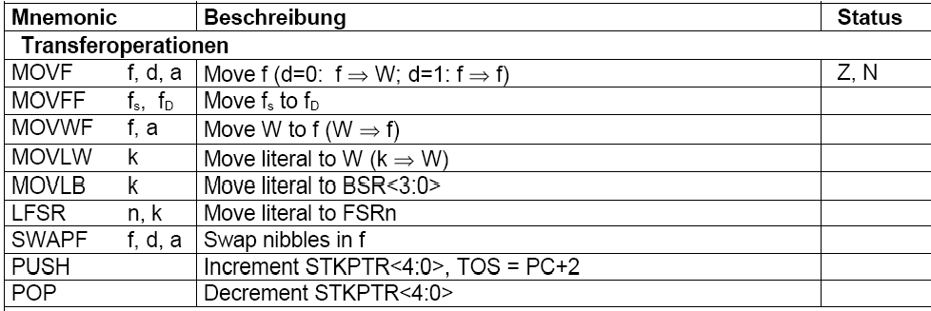
1.7 Status Register
Instruction That Affect Flag Bits

Slide 68
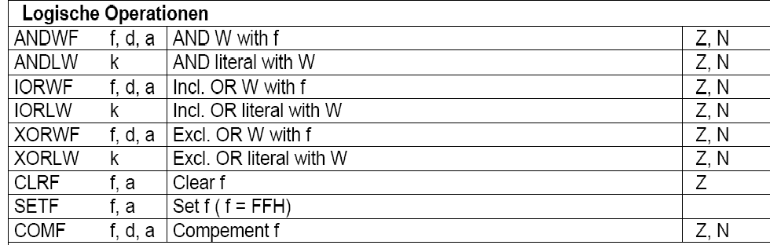
1.7 Status Register
Instruction That Affect Flag Bits

Slide 69
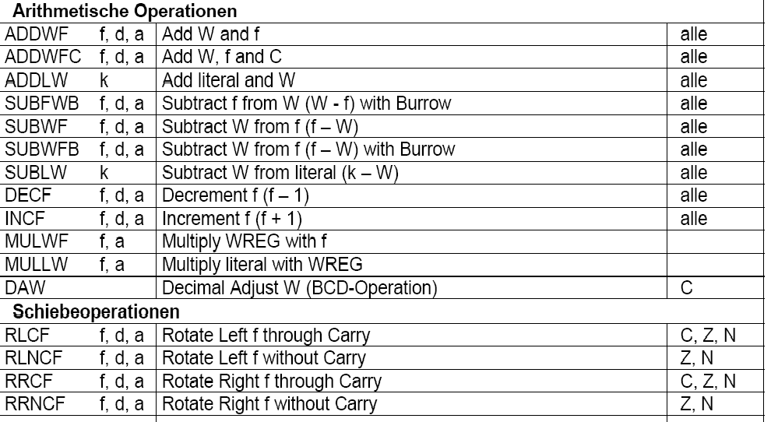
1.7 Status Register
Instruction That Affect Flag Bits

Slide 70
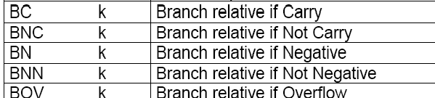

1.7 Status Register
Flag Bits and Decision Making

Slide 71
1.8 PIC18 Data Format and Directives
There is one data type
  8 bits
  It is the job of the programmer to break down data larger 8 bits
Data type can be positive or negative
Data format are
  Hex (default in PIC) 12 or 0x12 or H'12' or 12H
  Binary B'00010010'
  Decimal .12 or D'12'
  ASCII A'c' or a'c'

Slide 72
1.8 PIC18 Data Format and Directives
Assembler Directives
What is the difference between Instruction and Directives?
EQU
  Defines a constant or fixed address
SET
  Defines a constant or fixed address
  Maybe reassigned later
ORG (Origin)
END
LIST

Slide 73
1.8 PIC18 Data Format and Directives
Rules for labels in A.L.
Unique name
Alphabetic letters
  Upper, lower, digits (0-9),special char. (? . @_$)
The first letter must be Alphabetic letters
Not a reserved word

Slide 74
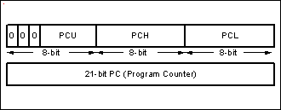
1.9 The Program Counter and Program ROM Space
Figure 2-9. Program Counter in PIC18

Slide 75
1.9 The Program Counter and Program ROM Space

Slide 76
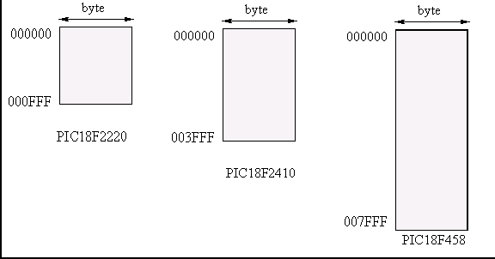
1.9 The Program Counter and Program ROM Space
Example 2-11:Find the ROM Memory Address of each of the following PIC chips:
PIC18F2220
PIC18F2410
PIC18F458

Slide 77
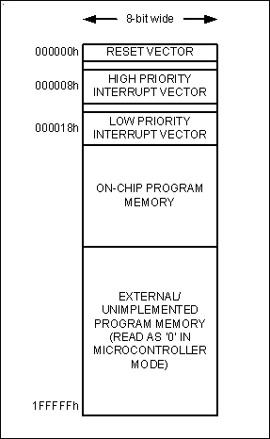
1.9 The Program Counter and Program ROM Space
Powering UP
At what address does the CPU wake up when power applied?
The microcontroller wakes up at memory address 0000
The PC has the value 0000
ORG directive put the address of the first op code at the memory location 0000

Slide 78




1.9 The Program Counter and Program ROM Space
Placing Code in program ROM

Slide 79
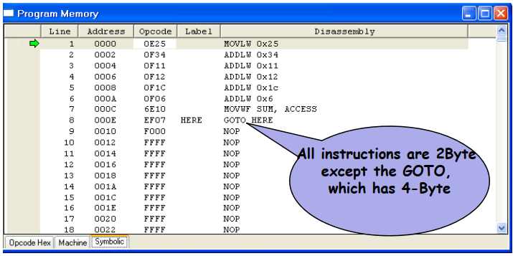
1.9 The Program Counter and Program ROM Space
Program Memory

Slide 80
1.9 The Program Counter and Program ROM Space
Program ROM Width for the PIC18
Byte addressable: each location holds only one byte
  CPU with 8-Bit will fetch one byte a time
  Increasing the data bus will bring more information
Solution: Data bus between CPU and ROM can be similar to traffic lanes on the highway
The wide of Data path is 16 bit
  Increase the processing power
  Match the PIC18 instruction €single cycle

Slide 81
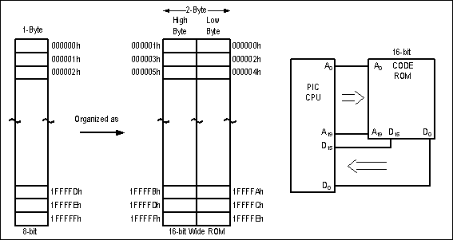
1.9 The Program Counter and Program ROM Space
Figure 2-12. Program ROM Width for the PIC18

Slide 82
1.9 The Program Counter and Program ROM Space
Little endian VS big endian war
The low byte goes to the low memory location
The high byte goes to the high memory location
Intel microprocessor and many microcontrollers use little endian

Slide 83
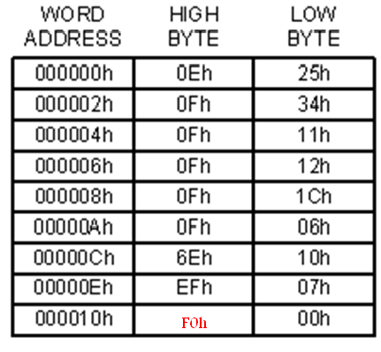
1.9 The Program Counter and Program ROM Space
Figure 2-13. PIC18 Program ROM Contents for Program 2-1 List File

Slide 84
1.10 RISC Architecture in the PIC18
Harvard Architecture in the PIC
Von Neumann Architecture: uses the same bus for accessing both the code and data memory.
  Slow down the processing speed
  Get in each other’s way
Harvard Architecture: uses separate buses for accessing the code and data memory.
  Inexpensive for a chip

Slide 85
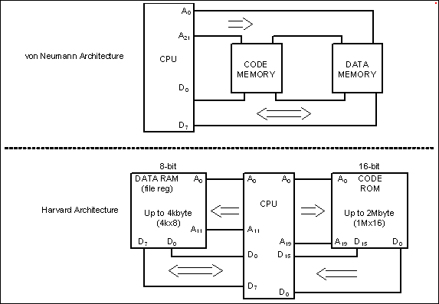
1.10 RISC Architecture in the PIC18
Figure 2-14. von Neumann vs. Harvard Architecture

Slide 86
1.10 RISC Architecture in the PIC18
RISC Architecture in the PIC
To increase the processing power of the CPU
  Increase the clock frequency of the chip
  Use Harvard architecture
  change the internal architecture of the CPU and use what is called RISC architecture

Slide 87
1.10 RISC Architecture in the PIC18
RISC Architecture in the PIC
RISC
Simple and Small instruction set
Regular and fixed instruction format
Simple address modes
Pipelined instruction execution --> 95% executed in one cycle
CISC
Complex and large instruction set
Irregular instruction format
Complex address modes
May also pipeline instruction execution

Slide 88
1.10 RISC Architecture in the PIC18
RISC Architecture in the PIC
RISC
Provide large number of CPU registers
Separated data and program memory
Most operations are register to register
Take shorter time to design and debug
CISC
Provide smaller number of CPU registers
Combined data and program memory
Most operations can be register to memory
Take longer time to design and debug

Slide 89
Summary
We have Compared between microprocessor and microcontroller
We have described the advantages of microcontroller
We have given a simple introduction for PIC18
PIC18 instruction
  Move, Add, Subtract

Slide 90
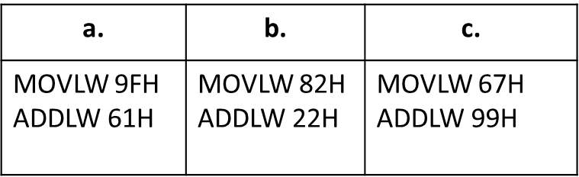
Review questions
Write instruction to move value 34H into the WREG register.
Write instruction to add the value 16H and CDH. Place the result in the WREG register.
True or False. Data space in PIC is SRAM memory, whereas program space is of the ROM type.
Write instruction to add the value 16H and CDH. Place the result in the location 0 of the file register.
5. Find the C, Z and DC flag bits for the following code
Give the value in WREG for the following
MYCOUNT EQU 15
MOVLW MYCOUNT
7. Give the value in fileReg 0x20 for the following
MYCOUNT EQU 0x95
MYCOUNT EQU 0x20
MOVLW MYCOUNT
MOVWF MYREG

Slide 91
Review questions
8. Give the value in fileReg 0x63 for the following
MYCOUNT EQU D’12’
MYCOUNT EQU 0x63
MYCOUNT EQU 0x10
MOVLW MYDATA
ADDLW FACTOR
MOVWF MYREG
9. The instruction “MOVLW 44H” is a _____-byte instruction.
10. The CISC architecture executes the vast majority of its instruction in 2,3, or more clock cycles, while RISC executes them in one clock. True or False?

